Slide 1
Use PyTorch to build neural networks

Slide 2

Key Concepts in PyTorch
Tensors are multi-dimensional arrays that are the fundamental data structure used in PyTorch.
Autograd automatically calculates gradients, which are used when training neural networks.
NN Module is the base class commonly used to define neural network models in PyTorch.
Optimizers update model parameters using calculated gradients in order to reduce the loss.
PyTorch is an open-source machine learning and deep learning library for Python.
PyTorch uses dynamic computation graphs, which are created as operations are performed.
PyTorch is widely used in both academia and industry for research and production.
Integration with Python: PyTorch operates more like a Python library than a framework.

Slide 3

How to Install PyTorch in Anaconda with Conda or Pip
Open the Anaconda Prompt or Terminal.
Create a new conda environment for PyTorch:
conda create --name pytorch_env python=3.10 -y
3. Activate the new environment:
conda activate pytorch_env
4. Install PyTorch using the command recommended for your system from the official PyTorch installation page. Then, for this bootcamp: pip install torch
pip install torch torchvision torchaudio --index-url https://download.pytorch.org/whl/cpu
5. Open Python IDE to verify the installation:
import torch
print(torch.__version__)
If using Google Colab, PyTorch is typically already available

Slide 4
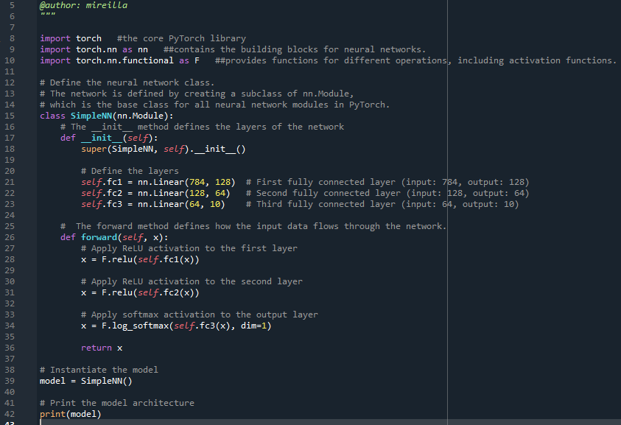
Example: Building a Simple Neural Network
Define a simple neural network with PyTorch's nn.Module.
Example: A fully connected network for a classification task.
e.g.:
self.fc1 = nn.Linear(784, 128) # 784 input features to 128 neurons

Slide 5

Popular activation functions in PyTorch
Logistic (or sigmoid) is a non-linear activation function.
  Useful for binary classification tasks. It takes any input and maps it to a value between 0 and 1 and is commonly used for binary-output probabilities.
Tanh maps input values to the range -1 to 1. Its outputs are centred around zero 0.
  can be computationally expensive
ReLU (Rectified Linear Unit) is a non-linear activation function that outputs the input value if it is positive, or 0 if it is negative. computationally more efficient, well-suited for large-scale neural networks.
Linear is a module provided by PyTorch that applies a linear transformation to the incoming data.
Non-linear activation functions allow neural networks to capture complex patterns in data, which is essential for tasks like image recognition, natural language processing, and other AI applications.

Slide 6
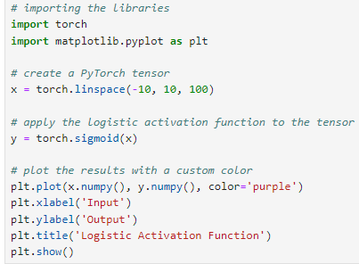
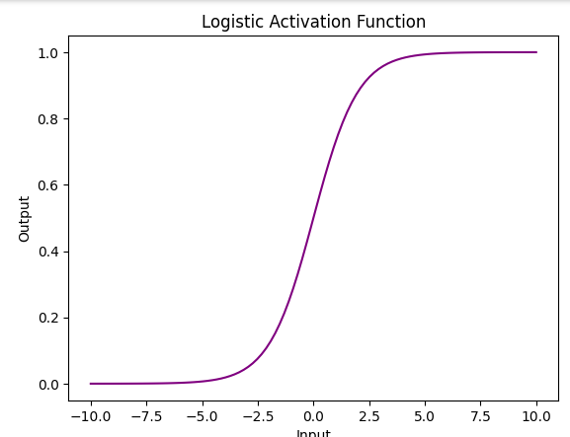
Logistic (or sigmoid) example
In a Jupyter notebook, packages can be installed with a command such as !pip install matplotlib if they are not already available.
-10: This is the start value of the tensor. The first element in the tensor x will be -10.
10: This is the end value of the tensor. The last element in the tensor x will be 10.
100: This specifies the number of equally spaced values between -10 and 10. The tensor x will contain 100 elements.

Slide 7
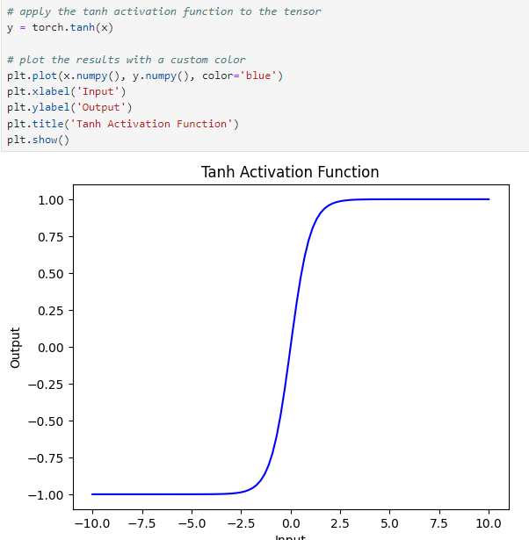
Tanh Activation Function example

Slide 8
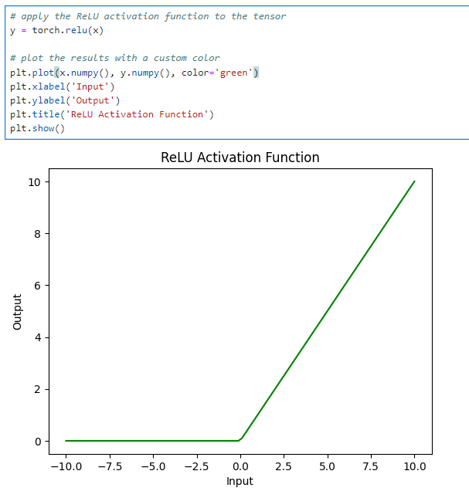
ReLU Activation Function

Slide 9
Neural Network Training Process
Phase 1 - Define the loss function measures how well the neural network’s predictions match the actual target values. It quantifies the error in the predictions, which the training process aims to minimise.
  Common loss function: Cross-entropy loss is commonly used for classification; mean squared error is commonly used for regression.
Phase 2 - Select an optimizer. The optimizer updates the neural network's weights based on the gradients of the loss function with respect to the weights. The goal is to minimize the loss function by iteratively adjusting the weights.
  Common optimizers: Stochastic Gradient Descent; Adam (Adaptive Moment Estimation)).

Slide 10
Neural Network Training Process
Phase 3 - Implement the training loop: Core process where the neural network learns from data. It involves feeding input data through the network, calculating the loss, and adjusting the weights to minimize the loss.
The steps are:
Clear previous gradients: Without clearing the gradients, PyTorch accumulates gradients by default across backward passes. optimizer.zero_grad()
forward pass: Pass the input data through the network to obtain predictions. outputs = model(inputs)
Compute loss: Calculate the loss using the loss function. loss = criterion(outputs, targets)
backpropagation: Compute the gradients of the loss with respect to the model's parameters. loss.backward()
Update Weights: Use the optimizer to update the weights based on the computed gradients. optimizer.step()

Slide 11
Summary
Conda
Google Colab
PyTorch

